Slide 1
NLP

Slide 2
Introduction to NLP
Semantic Parsing

Slide 3
Semantic Parsing
Converting natural language to a logical form
e.g., executable code for a specific application
Example:
Airline reservations
Geographical query systems

Slide 4
Stages of Semantic Parsing
Input
Sentence
Syntactic Analysis
Syntactic structure
Semantic Analysis
Semantic representation

Slide 5
Compositional Semantics
Add semantic attachments to CFG rules
Compositional semantics
Parse the sentence syntactically
Associate some semantics to each word
Combine the semantics of words and non-terminals recursively
Until the root of the sentence

Slide 6
Example
Input
Javier likes pizza
Output
like(Javier, pizza)

Slide 7
Example
S -> NP VP {VP.Sem(NP.Sem)} t
VP -> V NP {V.Sem(NP.Sem)} <e,t>
NP -> N {N.Sem} e
V -> likes {λ x,y likes(x,y) <e,<e,t>>
N -> Javier {Javier} e
N -> pizza {pizza} e

Slide 8
Semantic Parsing
Associate a semantic expression with each node
S: likes(Javier, pizza)
N: Javier
VP: λx likes(x,pizza)
Javier
V: λ x,y likes(x,y)
N: pizza
likes
pizza

Slide 9
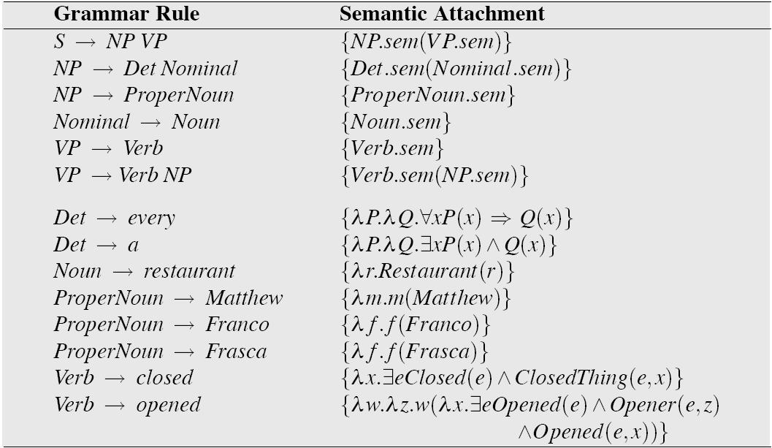
Grammar with Semantic Attachments
Example from Jurafsky and Martin

Slide 10
Using CCG (Steedman 1996)
CCG representations for semantics
ADJ: λx.tall(x)
(S\NP)/ADJ : λf.λx.f(x)
NP: YaoMing
YaoMing is tall
NP (S\NP)/ADJ ADJ
YaoMing λf.λx.f(x) λx.tall(x)
>
S\NP
λx.tall(x)
<
S
Tall (YaoMing)
Notes:
This slide appears in another file.

Slide 11
CCG Parsing
Example:
https://bitbucket.org/yoavartzi/spf
Tutorial by Artzi, FitzGerald, Zettlemoyer
http://yoavartzi.com/pub/afz-tutorial.acl.2013.pdf

Slide 12
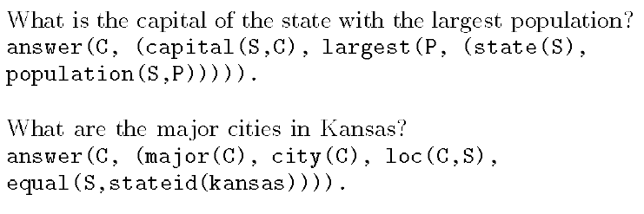
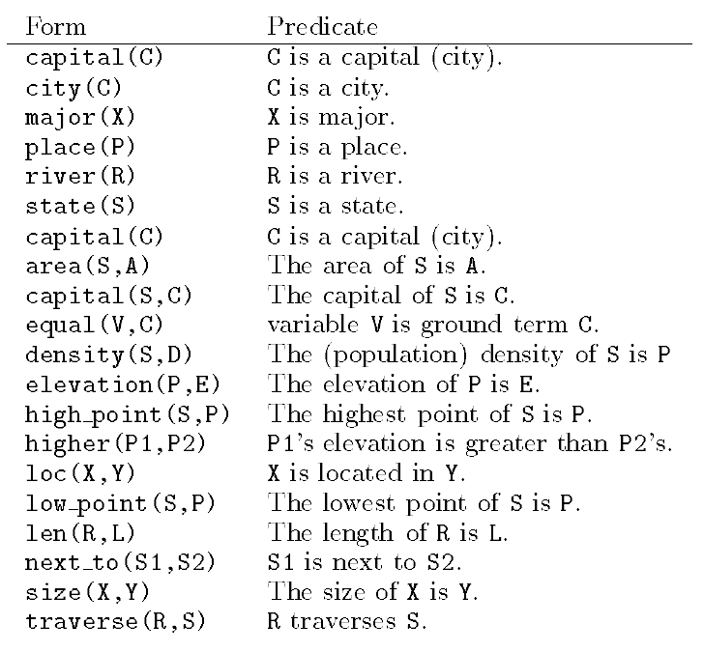
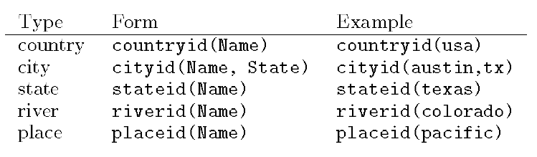
GeoQuery (Zelle and Mooney 1996)

Slide 13
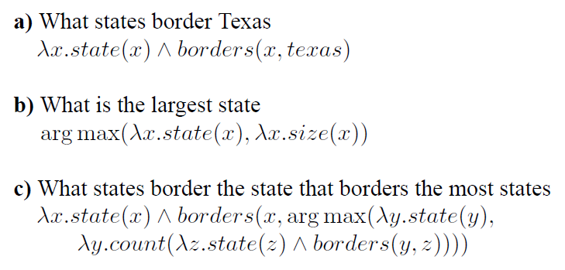
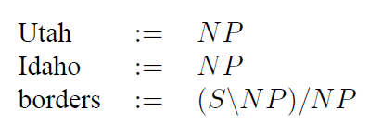
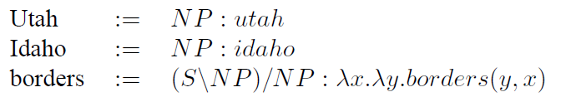
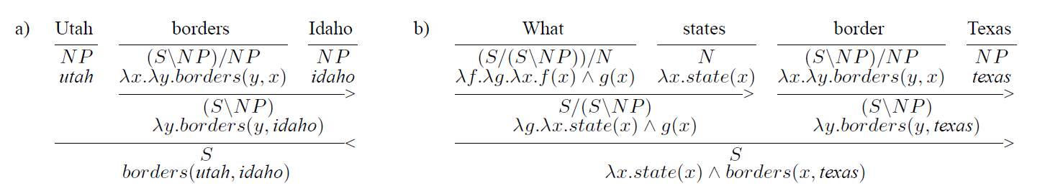
Zettlemoyer and Collins (2005)

Slide 14
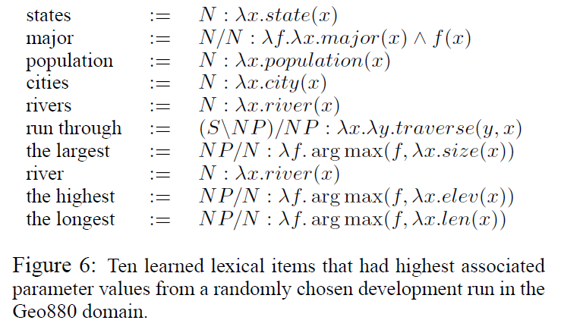
Zettlemoyer and Collins (2005)

Slide 15
Zettlemoyer and Collins (2005)
PCCG learning
Lexicon Λ, parameter vector θ
GENLEX

Slide 16
[Neubig 2017]

Slide 17
[Jia and Liang 2016]

Slide 18
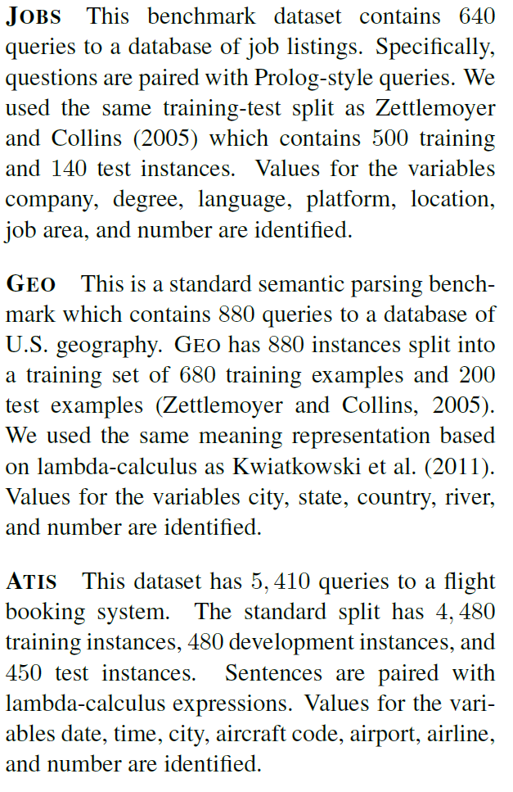
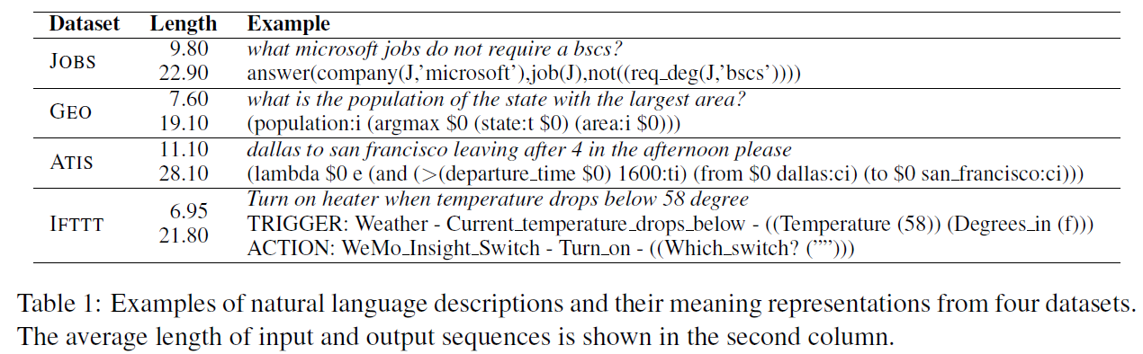
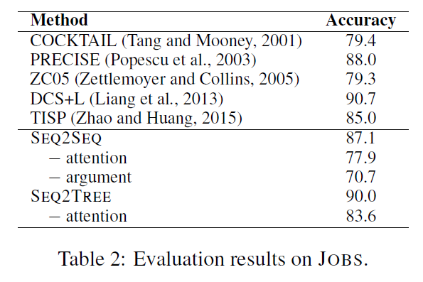
Dong and Lapata (2016)

Slide 19
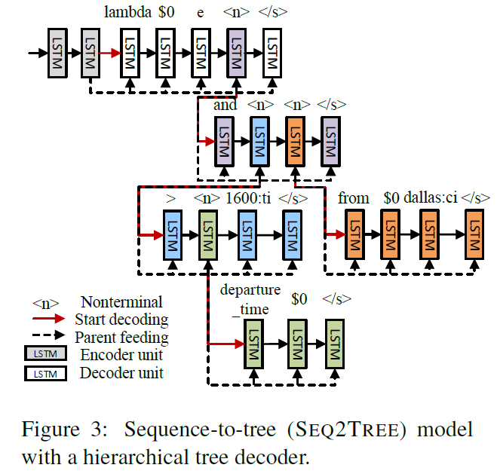
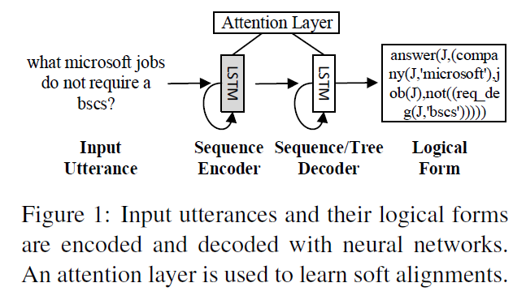
Dong and Lapata (2016)

Slide 20
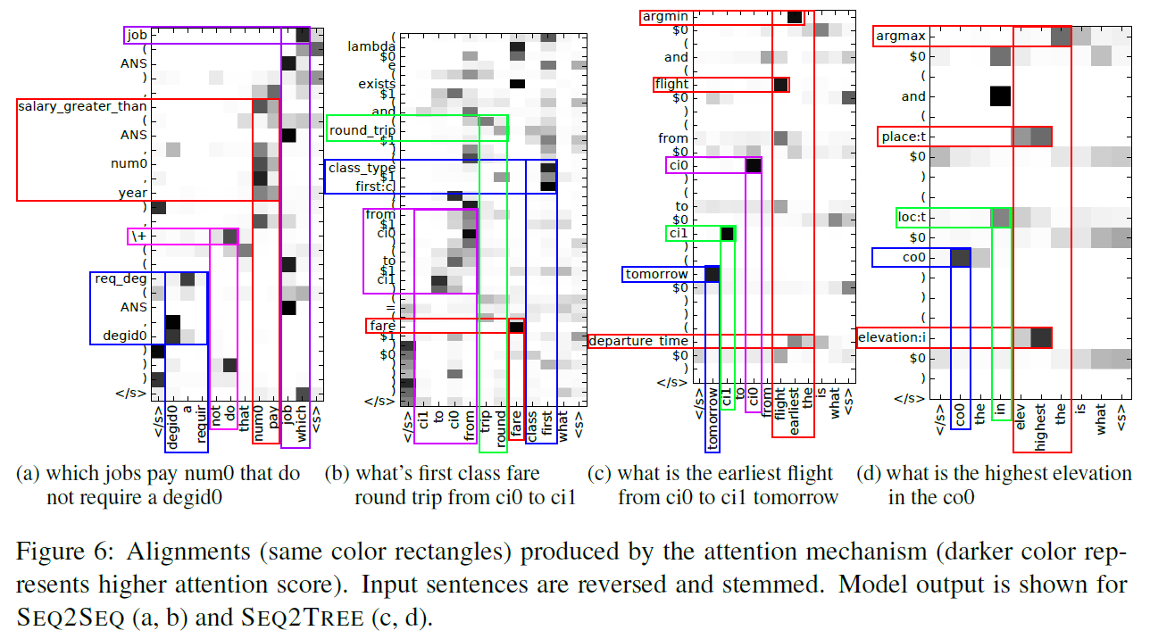
Dong and Lapata (2016)

Slide 21
Dong and Lapata (2018)

Slide 22
Dong and Lapata 2018

Slide 23
Dong and Lapata 2018

Slide 24
Introduction to NLP
Abstract Meaning Representation

Slide 25
Abstract Meaning Representation (AMR)
http://amr.isi.edu/
Single structure that includes:
Predicate-Argument Structure
Named Entity Recognition
Coreference Resolution
Wikification
[slide from Jonathan Kummerfeld]

Slide 26
Example
“Lassie ate four bones that she found.”
e / eat-01
Arg-0
Arg-1
a / animal
Arg-0
f / find-01
Arg-1
b / bone
n / name
wiki: “Lassie”
4
“Lassie”
[slide from Jonathan Kummerfeld]

Slide 27
Example
About 14,000 people fled their homes at the weekend after a local tsunami warning was issued, the UN said on its Web site
(s / say-01
:ARG0 (g / organization
:name (n / name
:op1 "UN"))
:ARG1 (f / flee-01
:ARG0 (p / person
:quant (a / about
:op1 14000))
:ARG1 (h / home :poss p)
:time (w / weekend)
:time (a2 / after
:op1 (w2 / warn-01
:ARG1 (t / tsunami)
:location (l / local))))
:medium (s2 / site
:poss g
:mod (w3 / web)))

Slide 28
Status of AMR
AMR currently lacks
Multilingual consideration
Quantifier scope
Co-references across sentences
Grammatical number, tense, aspect, quotation marks
Many noun-noun or noun-adjective relations
Many detailed frames, e.g. Earthquake (with roles for magnitude, epicenter, casualties, etc)
[slide from Jonathan Kummerfeld]

Slide 29
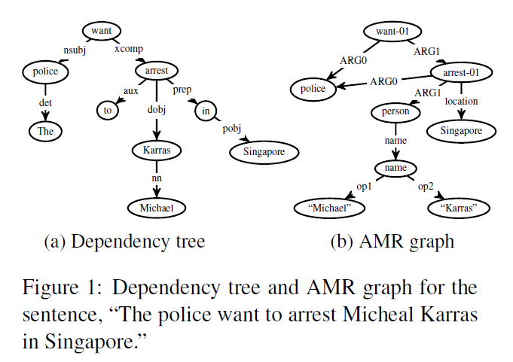
AMR Parsing (Wang et al. 2015,16)

Slide 30
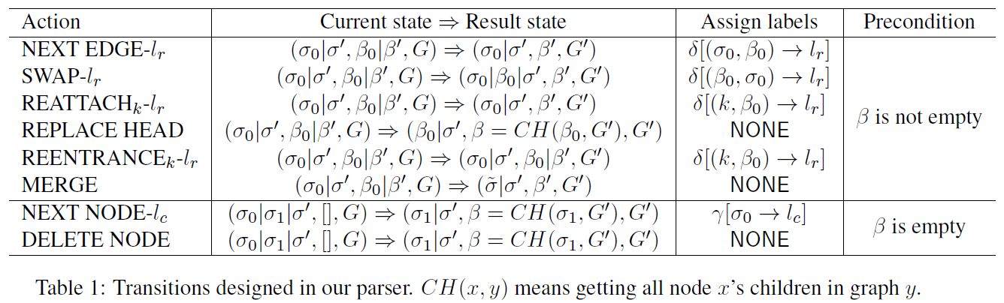
AMR Parsing (Wang et al. 2015,16)

Slide 31
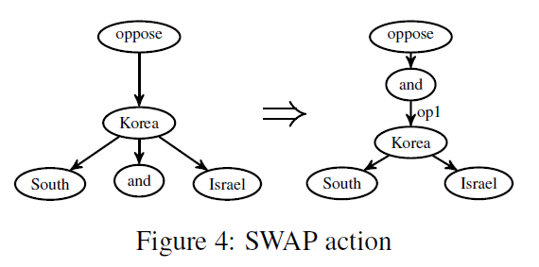
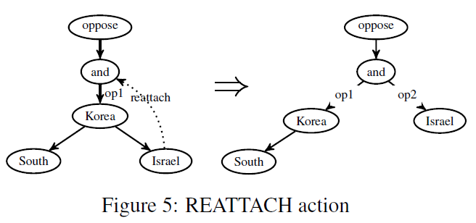
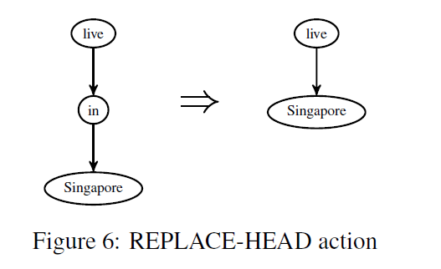
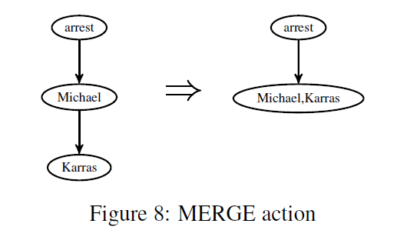
AMR Parsing (Wang et al. 2015,16)

Slide 32
Introduction to NLP
Natural Language to SQL

Slide 33
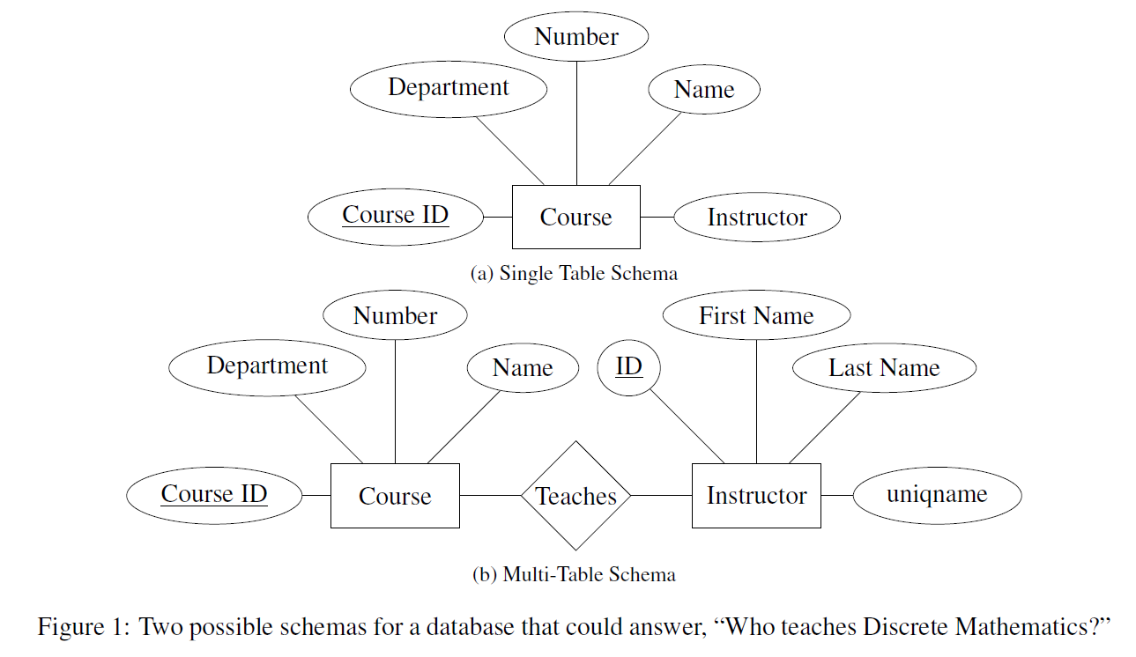
NL to SQL
[Finegan-Dollak et al]

Slide 34

Example: Text-to-SQL
SELECT I.NAME
FROM INSTRUCTOR AS I,
OFFERING_INSTRUCTOR AS OI,
COURSE_OFFERING AS O, SEMESTER AS S, COURSE AS C
WHERE OI.INSTRUCTOR_ID=I.INSTRUCTOR_ID
AND O.OFFERING_ID=OI.OFFERING_ID
AND O.SEMESTER=S.SEMESTER_ID
AND O.COURSE_ID=C.COURSE_ID
AND C.NAME=”NLP"
AND S.YEAR=2016 AND S.SEMESTER="FA"
“Who teaches NLP?”
Notes:
SQL is a programming language for interacting with relational databases.
We’re primarily interested today in SQL queries, which are used to retrieve specific information from the database. Interestingly, the way to express a natural language question as a SQL query depends on something called the schema of the database

Slide 35
All About SQL
Course
Instructor
Course ID | Dept. | Number | Name | Credits
1 | EECS | 203 | Discrete Math | 4
2 | LING | 137 | Epic Grammar Fails | 3
3 | EECS | 595 | NLP | 4
Instructor ID | First Name | Last Name
1 | Dragomir | Radev
2 | Walter | Lasecki
3 | Ezra | Keshet
4 | Rada | Mihalcea
Course Offering
Course ID | Instructor ID | Year | Semester
3 | 1 | 2016 | Fall
3 | 4 | 2017 | Fall
2 | 3 | 2018 | Winter
SELECT C.CREDITS
FROM COURSE AS C
WHERE C.NAME = “NLP”;
How many credits is NLP?

Slide 36
All About SQL
Course
Instructor
Instructor ID | First Name | Last Name
1 | Dragomir | Radev
2 | Walter | Lasecki
3 | Ezra | Keshet
4 | Rada | Mihalcea
Course ID | Dept. | Number | Name | Credits
1 | EECS | 203 | Discrete Math | 4
2 | LING | 137 | Epic Grammar Fails | 3
3 | EECS | 595 | NLP | 4
Course Offering
SELECT I.FIRST_NAME, I.LAST_NAME
FROM INSTRUCTOR AS I,
COURSE AS C,
COURSE_OFFERING AS CO
WHERE C.NAME = “NLP”
AND C.COURSE_ID = CO.COURSE_ID AND CO.INSTRUCTOR_ID =
I.INSTRUCTOR_ID;
Course ID | Instructor ID | Year | Semester
3 | 1 | 2016 | Fall
3 | 4 | 2017 | Fall
2 | 3 | 2018 | Winter
Who teaches NLP?

Slide 37
All About SQL
Course
Instructor
Course ID | Dept. | Number | Name | Credits
1 | EECS | 203 | Discrete Math | 4
2 | LING | 137 | Epic Grammar Fails | 3
3 | EECS | 595 | NLP | 4
Instructor ID | First Name | Last Name
1 | Dragomir | Radev
2 | Walter | Lasecki
3 | Ezra | Keshet
4 | Rada | Mihalcea
Course Offering
Course ID | Instructor ID | Year | Semester
3 | 1 | 2016 | Fall
3 | 4 | 2017 | Fall
2 | 3 | 2018 | Winter
SELECT C1.NAME
FROM COURSE AS C1
WHERE C1.CREDITS =
(SELECT MAX C2.CREDITS
FROM COURSE AS C2);
What course is worth the most credits?

Slide 38
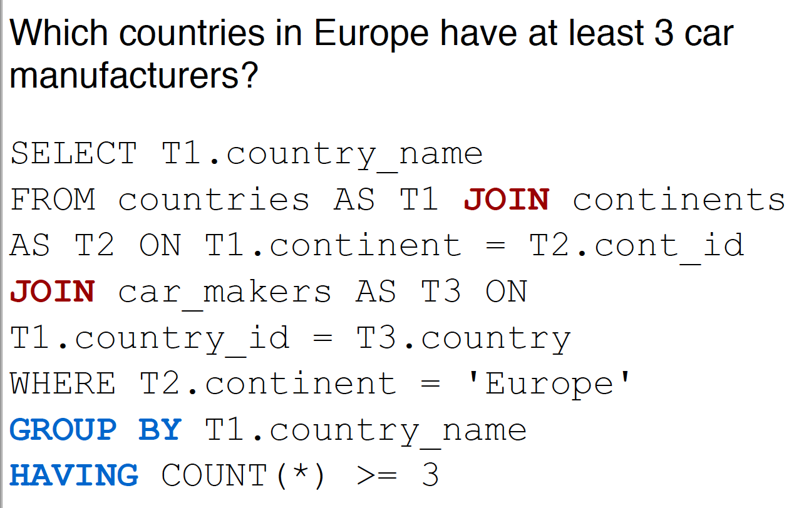
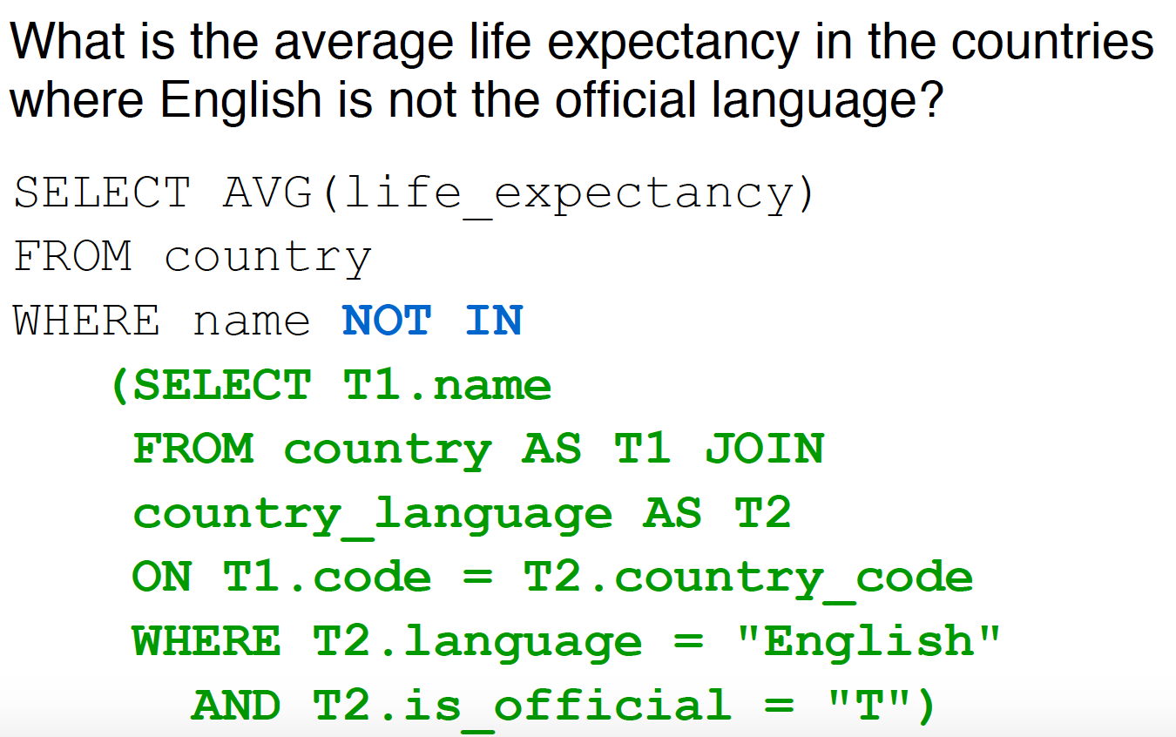
More Complicated SQL

Slide 39
CACM 1978

Slide 40
NLIDB Early Work
Very early work hand-engineered QA systems for specific databases (e.g., Lunar, Woods et al. 1972)
Precise (Popescu et al., 2004): Syntax-based, high precision, only a limited class of questions
The DB community has tried pattern matching and grammar-based methods; (e.g., Li & Jagadish 2014—grammar based + user feedback)
Transfer of techniques from logical semantic parsing (e.g., Poon 2013; Iyer et al. 2017)
Skip SQL with end-to-end systems (Yin et al. 2016, Neelakantan et al. 2017)

Slide 41
Limitations of Early Work
Very limited vocabulary
No machine learning
Lots of rules
Syntactic parsing
Overfitting
No distinction between training and testing data
The output was not SQL
introduced 1974, standardized 1986

Slide 42


Slide 43
Seq2SQL datasets are scarce!
Compared to other large datasets such as ImageNet for object recognition, building a decent seq2SQL dataset is even more time-consuming
Hard to find many databases with multiple tables online
Annotation requires very specific knowledge in databases

Slide 44
Traditional Seq2SQL datasets
Traditional 9 seq2SQL datasets: ATIS, Geo, Scholar, etc. + Advising
Pros
SQL queries cover complex SQL structures and components
Cons
The number of labeled queries is small (< 500)
Paraphrase about 4-10 natural language questions for each SQL query.
The total # of question-SQL pairs: ~500 -> ~5,000
Each of datasets contains SQL queries only to a single database

Slide 48
Standard Practice in ML
Split dataset into train set, test set, optional development (dev) set.
No training example can also appear in test set.
Bad Split
Good Split
Train
Test
Train
Test

Slide 49
How Do We Define an Example?
how many people are there in iowa?
select population
from state
where state_name = “iowa”
how many people live in utah?
select population
from state
where state_name = “utah”

Slide 50
Question-Based Split
Train
Test
how many people are there in iowa?
select population
from state
where state_name = “iowa”
how many people live in utah?
select population
from state
where state_name = “utah”
Query-Based Split
Train
Test

Slide 51
Prior Work: Improving Text-to-SQL Evaluation Methodology
Why Question-based split -> query-based split matters?
The text-to-SQL translation problem becomes a simpler classification problem if you have exactly the same SQL labels in the train and test splits.
Simpler classification problem:
input is natural language questions,
output classes are all unique SQL queries appearing in your train/test
Query-based split avoids this kind of cheating
https://arxiv.org/abs/1806.09029

Slide 52
Seq2SQL data – WikiSQL (Salesforce)
The first realistic seq2SQL task definition on the top of WikiSQL makes it the most popular seq2SQL dataset
Databases in the test set do not appear in the train/dev set, which requires model to generalize to new databases
https://github.com/salesforce/WikiSQL

Slide 53
Seq2SQL data – WikiSQL (Salesforce paper)
WikiSQL - Pros
The number of SQL queries and databases is huge (>20,000)
Databases in the test set do not appear in the train/dev set, which requires model to generalize to new databases
WikiSQL - Cons
SQL queries are generated by templates and paraphrased by Turkers
All databases have only one table - not a full relational database
SQL only contains SELECT and WHERE. No GROUP BY/Nested queries etc.

Slide 54
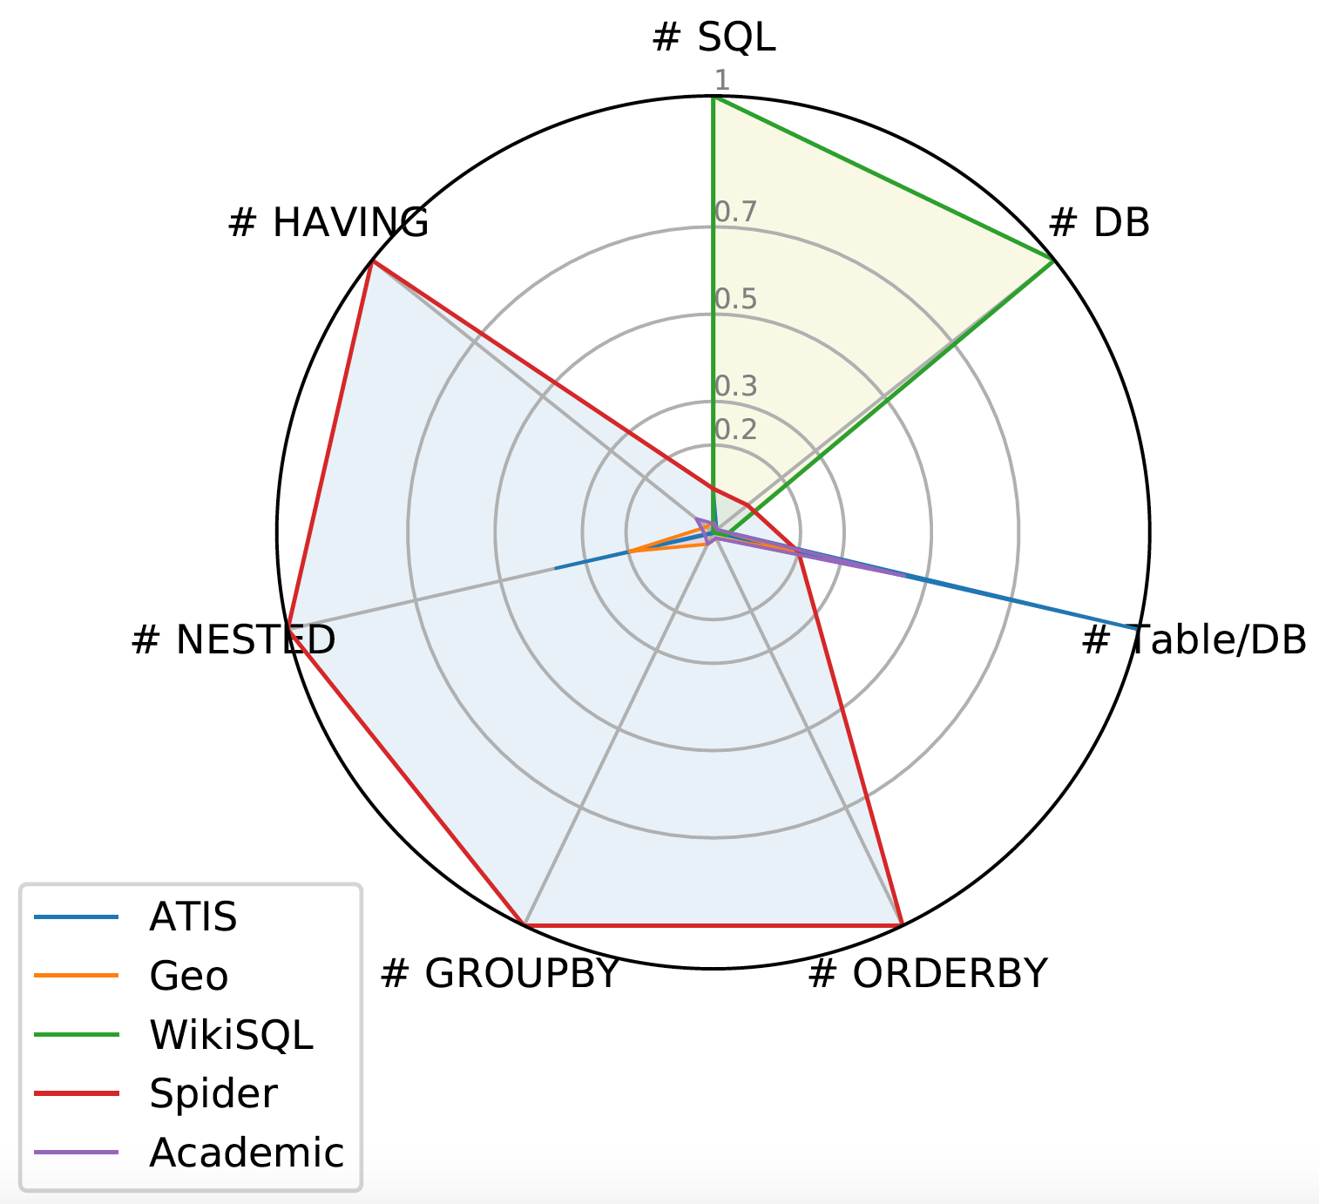
Seq2SQL data - Spider
WikiSQL is great. But it has limited
SQL coverage and a very simple
schema, which makes the
task simple and less interesting
[Yu et al. 2018]

Slide 55
Seq2SQL data - Yale Spider
SQL labels cover almost all important SQL components
Each database has multiple tables and several foreign keys
It is currently the only large-scale complex and cross-domain semantic parsing and text-to-SQL dataset!
Check it out!!!
Our Blog
Project Page: https://yale-lily.github.io/spider
Github Page: https://github.com/taoyds/spider

Slide 56
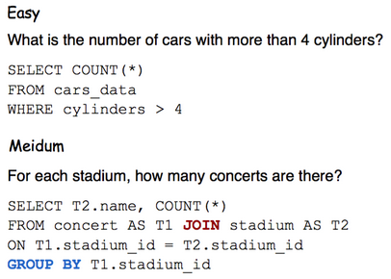
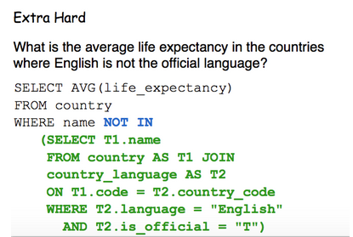
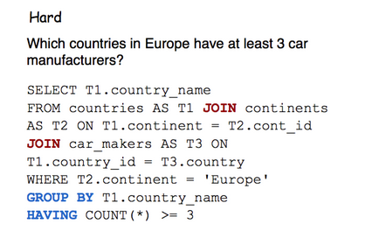
Query Difficulty

Slide 57
NLP

